Slide 1
Openstack July Meetup 2012
Overiew and InstallFest
Deepak Garg
Citrix R&D, Bengaluru
deepakgarg.iitg@gmail.com
Openstack July Meetup 2012 by Deepak Garg is licensed under a Creative Commons Attribution-ShareAlike 3.0 Unported License.
Based on a work at www.slideshare.net/khinnu4u/presentations.

Slide 2
Contents
Infrastructure ?
IaaS
Why IaaS ?
My DC !
How it looks to the User !
Components
Simple WorkFlow
Openness and Culture
Community in India

Slide 3
Infrastructure ?
Physical Servers
L2/L3 Switches
Storage – all types
Cost Efficiency
Space Efficiency
Usage Efficiency
Should Work !

Slide 4
IaaS
Compute as a Service → VMs
Storage as a Service → Storage space
Networking as a Service → configure the kind of networking you need

Slide 5
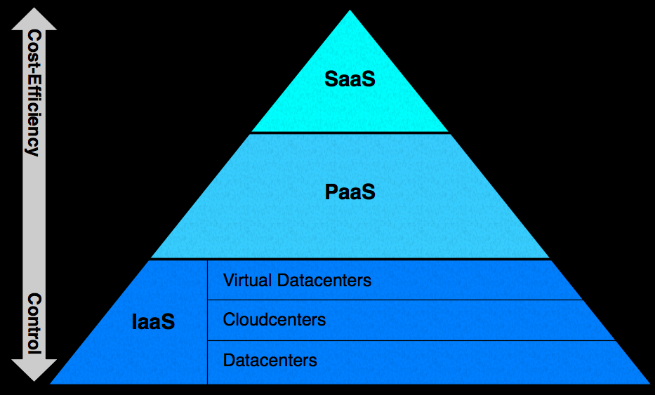
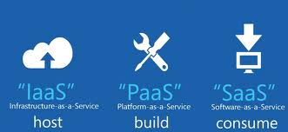
IaaS PaaS SaaS

Slide 6
My DC !
DB VMs
Web VMs
Switch 1
Switch 2
Physical Hosts
S1
S16
S2
S3
S4
S5

Slide 7
How it looks to the User !
Compute
Pooling the compute. To the user, it can serve scalable and infinite compute on demand
Pooling the storage. To the user, it can serve scalable and infinite storage on demand
Abstraction
Scalable
On-Demand

Slide 8
Openstack Components
Nova – Openstack Compute
Swift – Openstack Object Storage
Glance – Openstack Image Service
Keystone – Openstack Identity Service
Horizon – Openstack Dashboard
Quantum – Openstack Networking Service
Others:
Atlaas – Load Balancing as a Service

Slide 9
Nova
VM lifecycle → provisioning, maintaining
~ Amazon EC2, RAX Cloud Servers, VPS
Also provides volume service ~ EBS
Further divided into logical components: nova-api, nova-compute, nova-network,
- nova-schedule:- decides which physical host the VM should run. Scheduling algos can be very simple or very complex
- nova-api:- provides endpoint for OS/EC2 API, initiates req.
- nova-compute:- lifecycle of VMs
- nova-volume:- creates, attaches, detaches persistent vols
- nova-network:- provisioning vifs, firing iptable rules

Slide 10
Swift
Object Blob Store
~ Amazon S3 or RAX Cloud Files
Distributed architecture -- no SPOF, scale horizontally
- Proxy Server:- provides API endpoint
- Account Server:- manage accounts
- Container Server:- maps containers (folders)
- Object Server:- manage actual files/objects

Slide 11
Keystone
Users and Tenants management
AuthN and AuthZ services
~ Amazon IAM
All components talk to Keystone
Give your username/password and get a token
- Pass token to other services for the API calls you make
- Services verify that token with Keystone for AuthN / AuthZ
- Pluggable backend → LDAP, SQL, Key-Value stores

Slide 12
Glance
Discover, Storage and Retrieval of VM images for Nova
Can use Swift or any other filesystem for backend storage
Optional component but recommended
- glance-api:- provides api endpoint
- glance-registry:- metadata about images
- image-store:- could be swift / S3 etc.

Slide 13
Horizon and Quantum
GUI for admins, tenants and users
Uses keystone API for commands
Quantum:
- plays with switches → physical and virtual
- pluggable architeture → drivers available for OVS, Nicira, Cisco etc., write your own proprietary driver

Slide 14
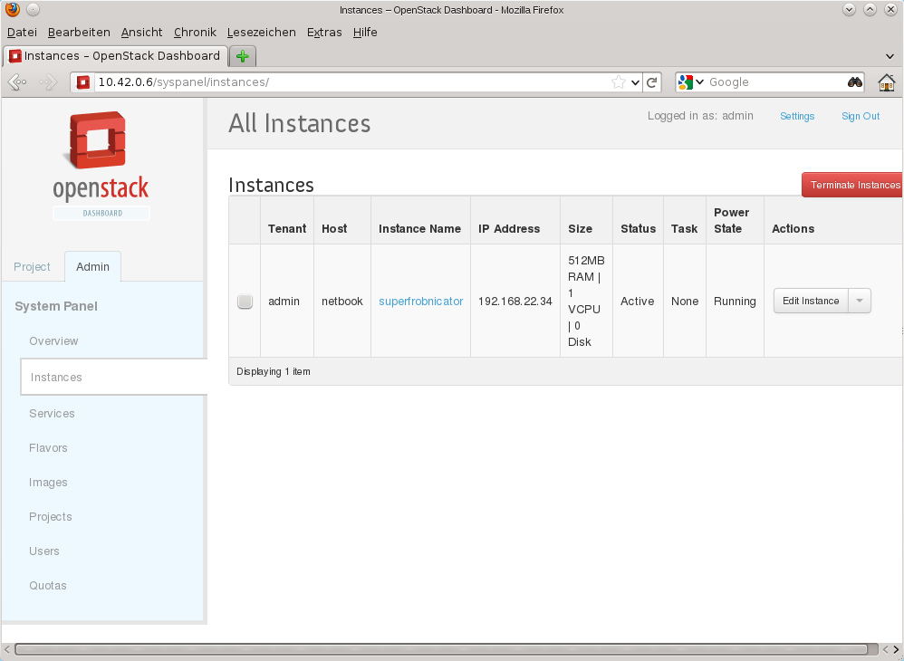

Slide 15
The Others
Queuing Service → RabbitMQ or any AMQP
DB → MySql, Postgres, Sqlite
Apache with mod_wsgi → Dashboard

Slide 16
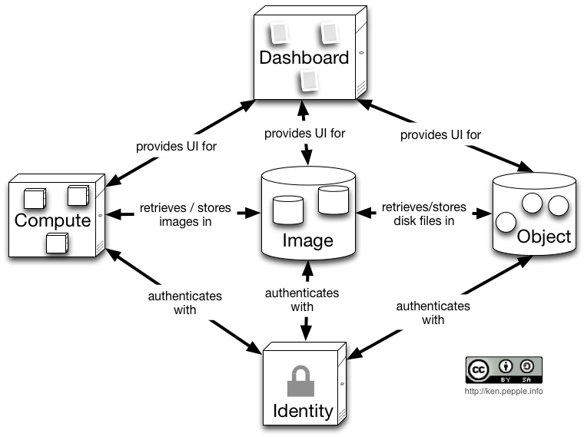
Simple Workflow

Slide 17
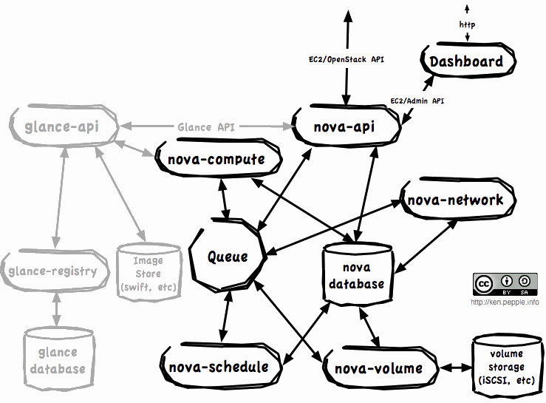
Simple WorkFlow 2.0

Slide 18
Openness and culture
Open Source → Apache 2.0
Open Design → Design Summit and Dev conf for every release
Open Dev → github, Launchpad and gerrit
Open Community → PTLs and PB members elected by the community

Slide 19
Community in India
ML: openstackindia@librelist.com
Meetup Page: http://www.meetup.com/Indian-OpenStack-User-Group/
LinkedIn: Openstack India community http://www.linkedin.com/groups/OpenStack-India-4005742
FB: Openstack India User Grp http://www.facebook.com/groups/328814400511881/
Python Developers Meetup page:
http://www.meetup.com/Bangalore-Python-Developers-Group/

Slide 20
Many Thanks !
  deepakgarg.iitg@gmail.com
  @donji
  github.com/gargdeepak

